Slide 1
Introduction to CRT
February, 2015

Slide 2
Credit Risk Transfer Deals
Deal Summary:
Credit Linked Notes issued by Freddie Mac or Fannie Mae
A hypothetical structure mimics the cash flow of mezzanine tranches
Investors do not have recourse to loans in the reference pool
Notes are unsecured debt of GSEs. Priority on par with agency debentures
Notes are uncapped par-priced LIBOR indexed floaters with 10Yr legal final maturity
Collateral Summary:
Fully amortizing, 30Yr, Fixed Rate, 1st Lien loans on 1-4 unit homes
All loans originated with 9-12 months prior to issuance
None of the loans have missed any payments prior to issuance
Full Doc loans
LTV between 60-80 or 80-97 for High LTV deals.
No modifications, no HAMP loans, no MI (for 60-80 LTV), no RefiPlus, no Balloons or IOs

Slide 3
Issuance to Date

Slide 4
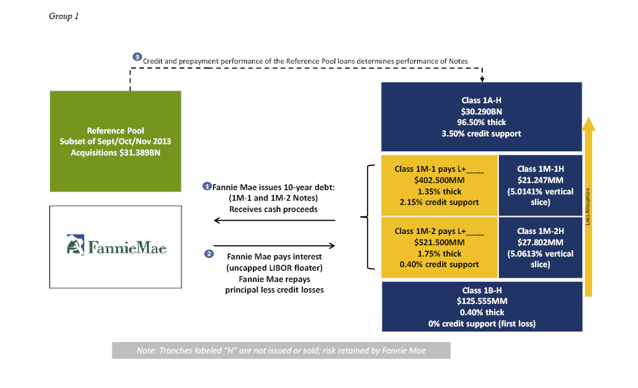
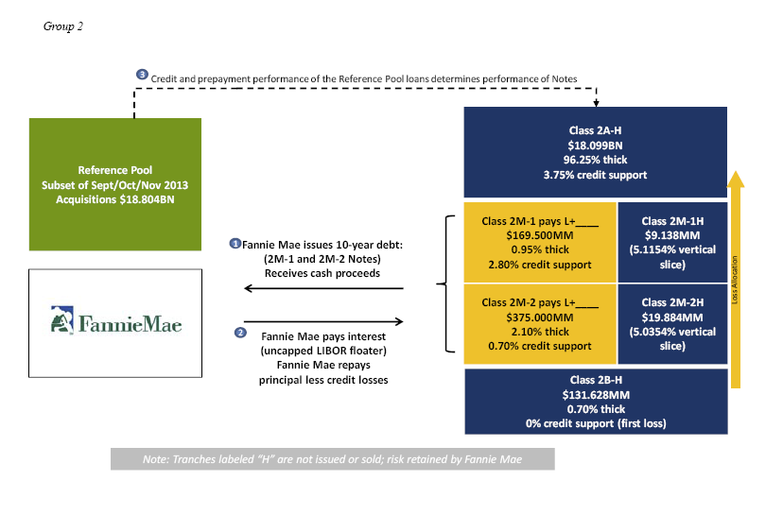
Illustrative Structure – CAS 2015-C01

Slide 5
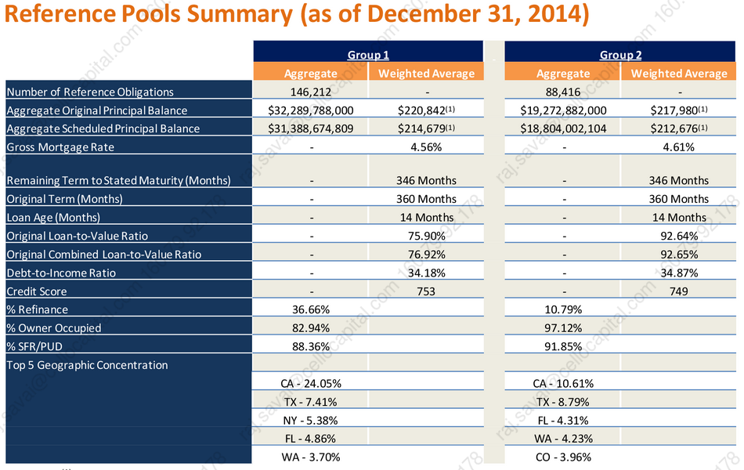
Illustrative Structure – CAS 2015-C01

Slide 6
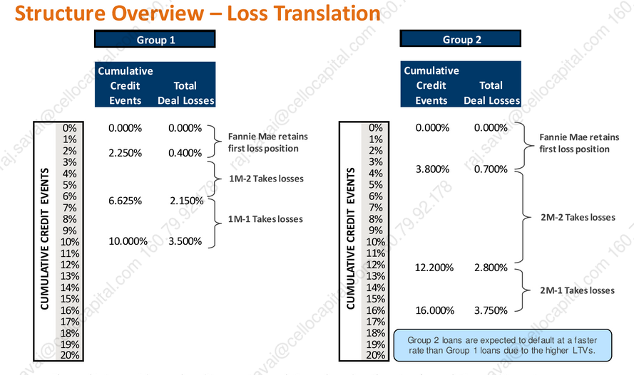
Illustrative Structure – CAS 2015-C01

Slide 7
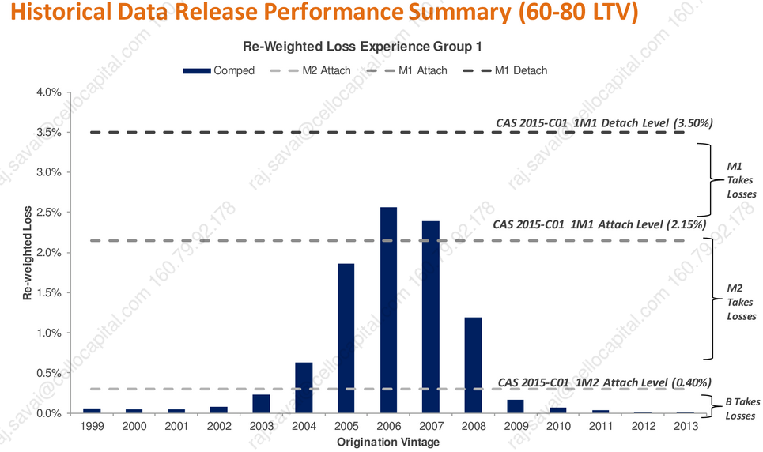
CAS 2015-C01 (60-80 LTV)

Slide 8
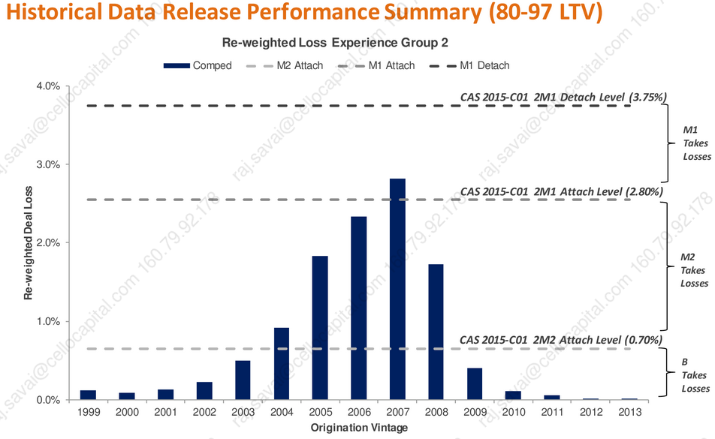
CAS 2015-C01 (80-97 LTV)

Slide 9
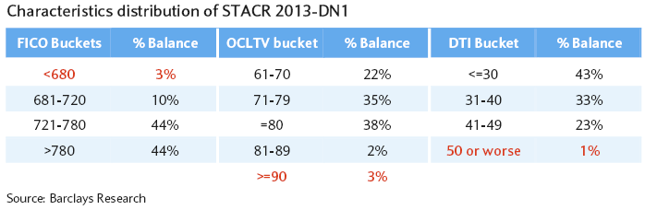
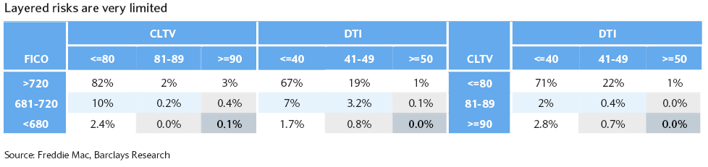
Layered Risk
Analysis of Layered Risk is Crucial

Slide 10
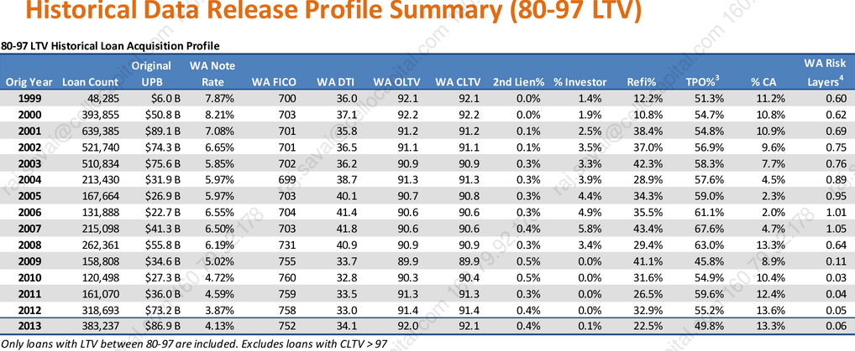
Layered Risk

Slide 11
Waterfall & Performance Triggers

Slide 12
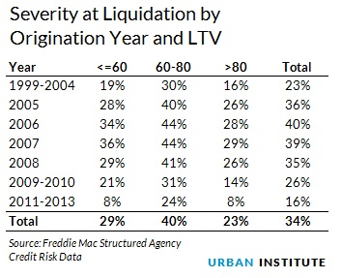
Loss Severity
Severity Schedule:
Historic Severity

Slide 13
CAS Spreads

Slide 14
STACR Spreads

Slide 15
STACR Spreads

Slide 16
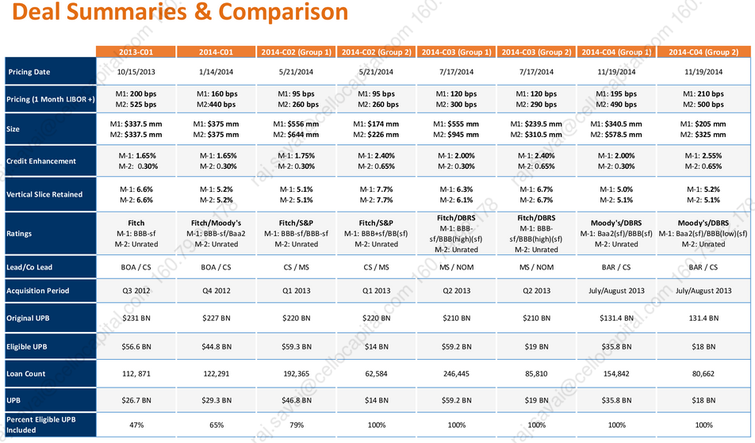
Comparision to Prior CAS deals

Slide 17
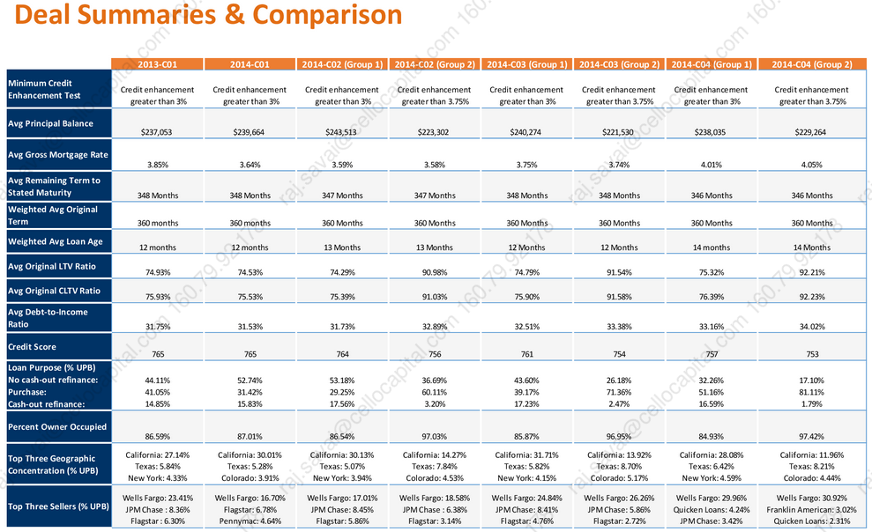
Comparision to Prior CAS deals

Slide 18
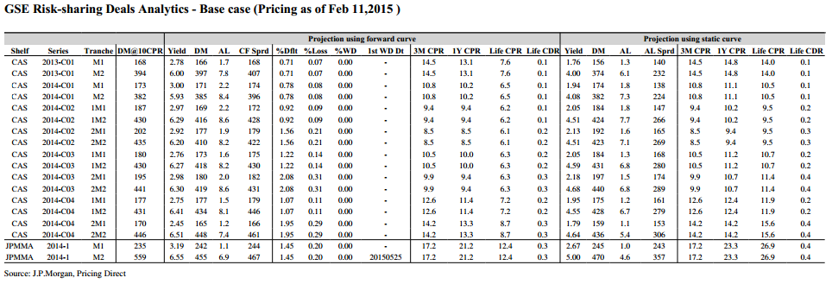
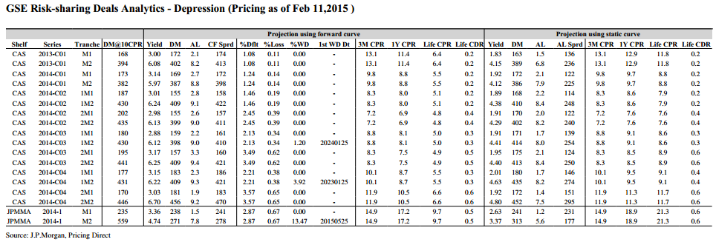
JP Morgan Analytics

Slide 19
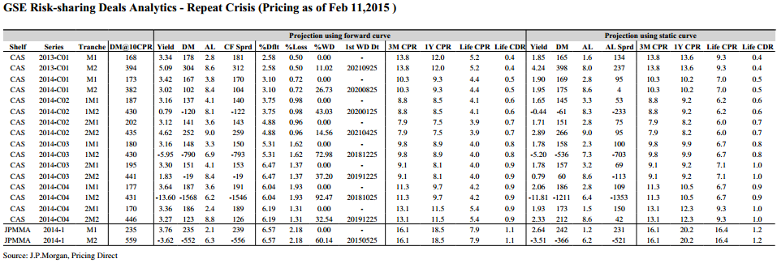
JP Morgan Analytics
Tranche | Risks
M1 | Do not take writedowns even in severe stress scenario Primary risk is extension risk MtM Vol especially if leveraged
M2 | Generally do not take writedowns in Base & Stress Cases CF profile similar to 10 yr bullet – AL usually over 7 years at current prepayment levels

